Slide 1
Google Docs
By Abira. Y & Muktika. M

Slide 2

Online Software
Used to write essays, reports, letters, or resumes
Can be used on any devices
Dominate over Microsoft Word
What is Google Docs?

Slide 3


Visually impaired
Hearing impairment
Motor Coordination
Accessibility
Notes:
Accessibility

Slide 4
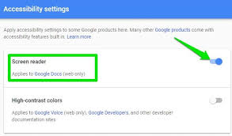

Difficulties:
Low ability/Unable to see the screen
Needs help
Solutions:
Reader support
Keyboard shortcuts
Visually impaired
Notes:
Accessibility

Slide 5

Difficulties:
None
Solution:
Nothing
Hearing Impairment

Slide 6
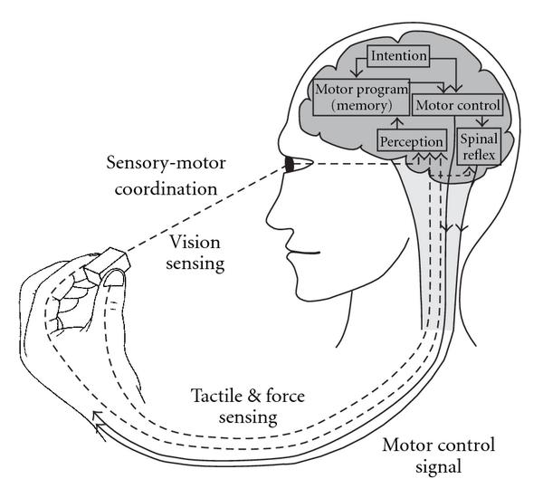
Issues faced:
Might not be able to
access keyboard
Solutions:
Accessibility features
Motor coordination

Slide 7

Accessibility
More audio options/interactive
Keyboard shortcuts will be easy to access and learn
What if?

Slide 8
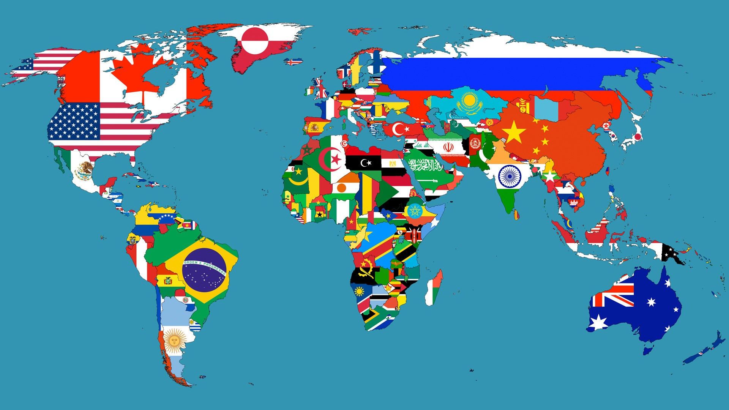
LANGUAGE
LOCATION
Regionalization
Notes:
Regionalization

Slide 9

Issues in Googles Docs
Only most spoken languages in the world are used
Low vocabulary and spelling check for other languages
Language
Notes:
Regionalization

Slide 10
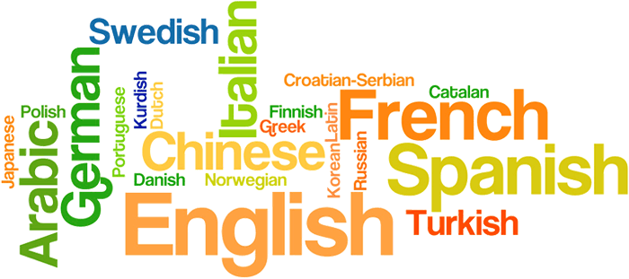
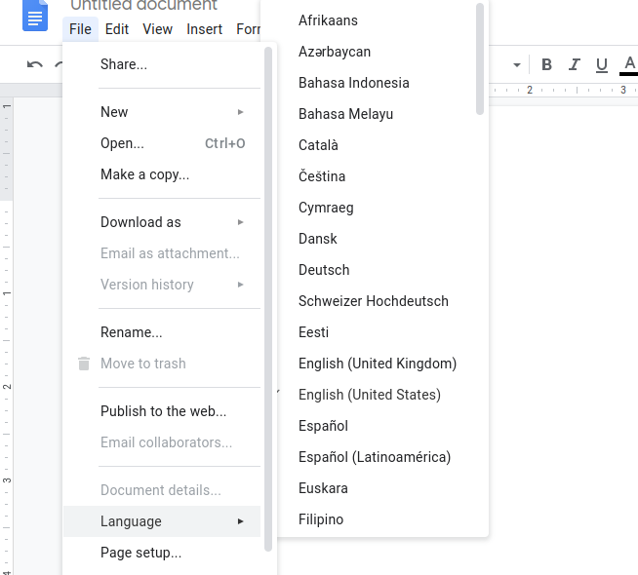
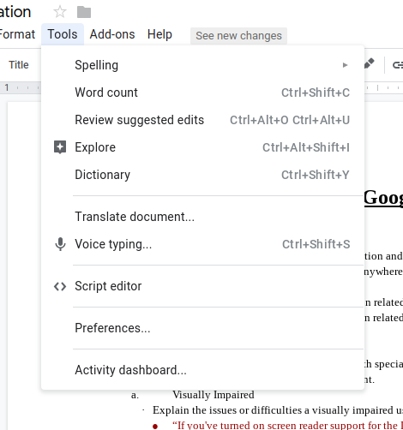

Special keyboard to write in different languages
Voice Typing
The Pros of Google Docs for Language
Notes:
Regionalization

Slide 11
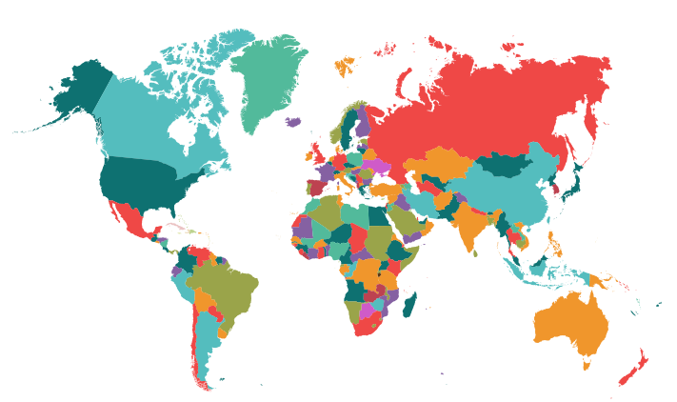
Issues in Googles Docs
Default Language - English
Banned in few countries
Example: China
Not relied on by some countries
Location
Notes:
Regionalization

Slide 12

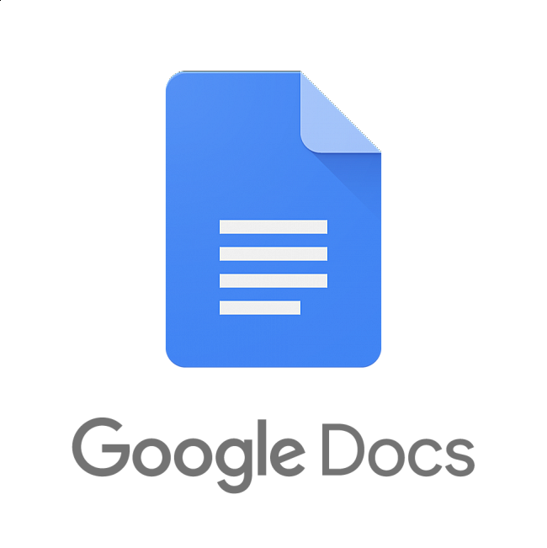
Regionalization
Official languages of Sweden
Default Language - Might be English or not
Less fluent or accurate in foreign languages
Less access to other countries
What if?
Notes:
Regionalization

Slide 13

Google Docs _________________________
Is a great application
Has flaws
Can be perfect for us
Can be a challenge for people who have difficulties physically, through knowledge or location
Conclusion

